Slide 1


IILM University
Artificial Intelligence Internship
Name: Praveen Mishra
Enrollment Number: 25scs1003001114
Program & Semester: B-tech CSE & 3rd
Organization Name: Codec Technologies

Slide 2

AI Training Program Graduate
Comprehensive Training
Practical Applications
Completed a rigorous AI Training Program at Codec Technologies, covering both theory and applied practice.
Mastered AI fundamentals and translated classroom knowledge into hands-on project delivery.
Certified Professional
Earned industry-level certification demonstrating competency in modern AI concepts and tools.

Slide 3

CODEC TECHNOLOGIES
1-Month AI Internship Experience
Position: Artificial Intelligence Intern
Duration: June 12 – July 12, 2026
Focus: Hands-on experience with real-world AI projects and professional tasks
A full-immersion internship working alongside industry professionals to deliver meaningful AI-driven outcomes.

Slide 4



Core Skills Developed
Technical
Professional
Soft Skills
AI fundamentals & model design
Problem-solving & debugging
Technical implementation
Project execution & delivery
Task management & prioritization
Team collaboration
Clear communication
Initiative & self-learning
Dedication & adaptability

Slide 5

PROJECT 1
Email Spam Detector
Built a machine learning model capable of accurately classifying incoming emails as spam or legitimate — putting real ML into production-style practice.
Applied AI algorithms for text analysis and pattern recognition
Trained and evaluated classification model performance
Demonstrated end-to-end practical ML implementation skills

Slide 6
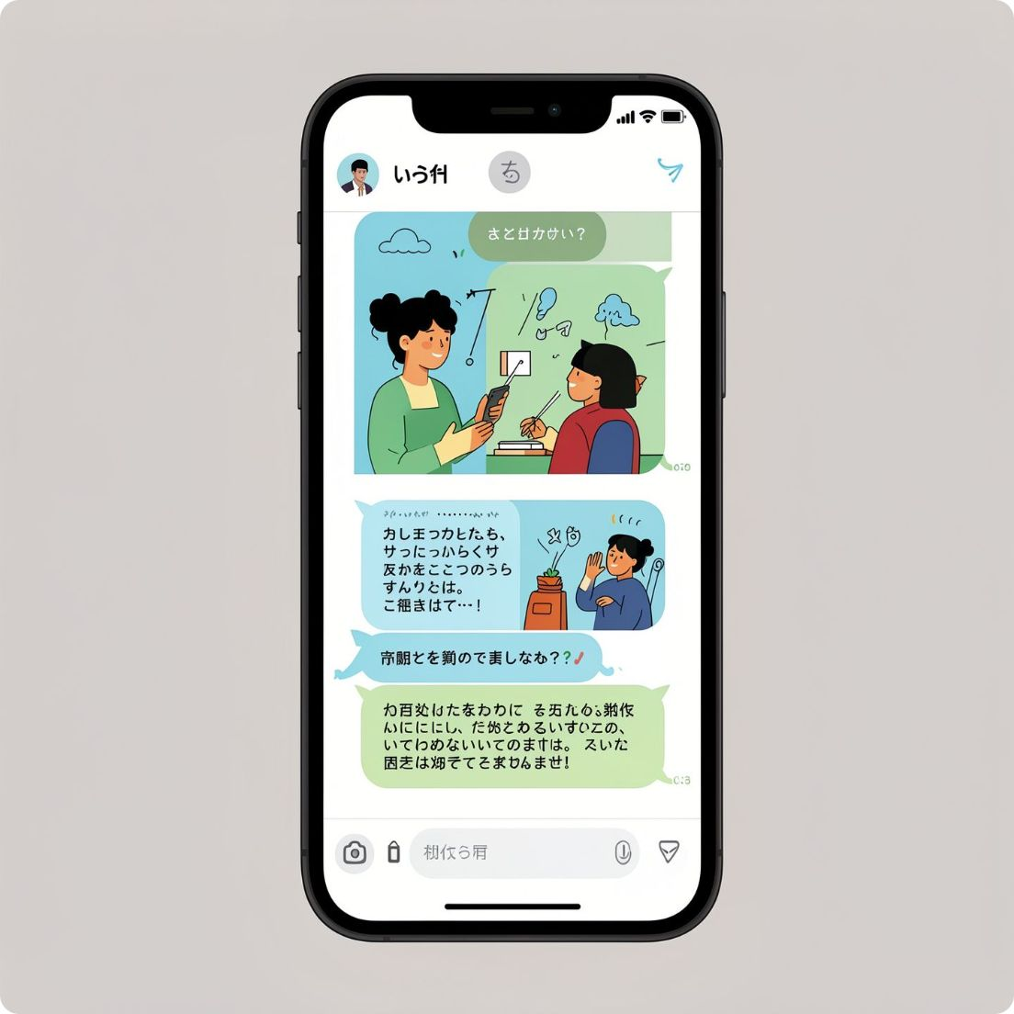
PROJECT 2
Customer Service Chatbot
Developed a conversational AI chatbot designed to automate and enhance customer support interactions — showcasing applied NLP from the ground up.
Implemented natural language processing (NLP) capabilities
Designed dialogue flows for realistic customer interactions
Enhanced customer interaction automation and response quality

Slide 7



Key Achievements
1
2
AI Training Certification
Internship Completed
Successfully completed the full AI Training Program at Codec Technologies.
Finished the one-month AI Internship with consistently strong performance throughout.
3
Letter of Recommendation
Received a formal Letter of Recommendation from Codec Technologies acknowledging excellence.

Slide 8


Recognition & Recommendations
Recognized for outstanding dedication, enthusiasm, and professionalism throughout the internship engagement.
Praised for strong technical skills and exceptional work ethic on every project undertaken.
Recommended for future opportunities by Codec Technologies — a testament to performance and potential.

Slide 9

AI/ML Development
Competencies Demonstrated
AI/ML model development — from design through deployment
Complex problem-solving — tackling real-world technical challenges
Independent & collaborative — ability to thrive both solo and in a team
Quick learning — rapid adaptation to new technologies and workflows
Rapid Learning & Adaptation
Complex Problem‑Solving
Independent & Collaborative

Slide 10

Why This Matters
Real-World Experience
Proven Delivery
Hands-on AI work in a live professional environment — not just theory.
Demonstrated the ability to build and deliver functional AI solutions end-to-end.
Strong Foundation
Fully equipped for AI engineering and data science roles from day one.

Slide 11


OPEN TO OPPORTUNITIES
Ready for the Next Challenge
With certified training, a completed internship, two delivered AI projects, and a Letter of Recommendation in hand — Praveen Mishra is ready to contribute from day one.
Seeking AI/ML Engineering or Data Science opportunities
Equipped with practical skills and strong industry recommendations
Committed to continuous learning and driving innovation forward
Let's connect — open to full-time roles and collaborative projects in AI.

